Slide 1

Calculus I Sneak Peak
CSM PRESS 2025

Slide 2
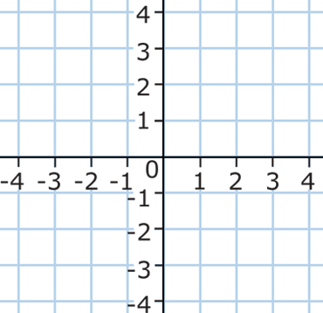

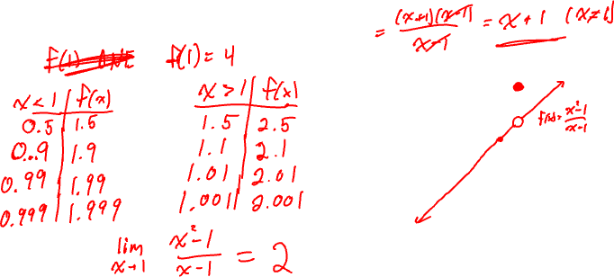
Limits
EXAMPLE: Consider the function $f\left(x\right)=\frac{x^{2}−1}{x−1}$.

Slide 3
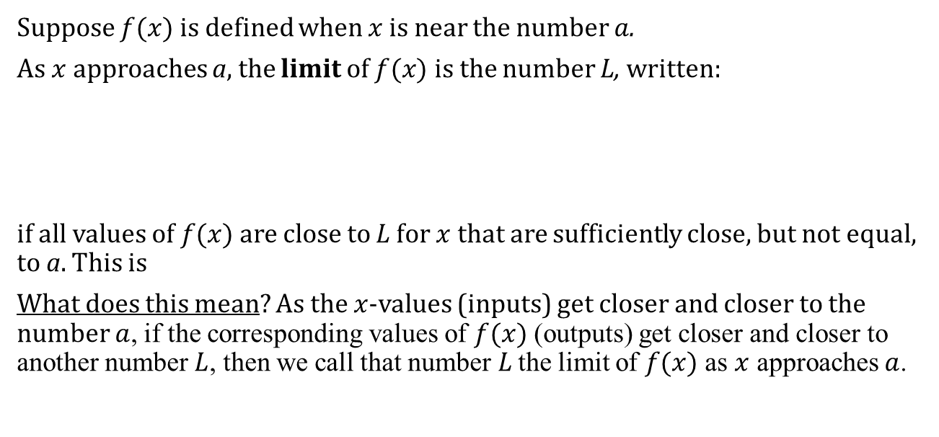
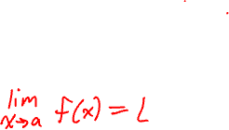
Limit Definition
Suppose $f(x)$ is defined when $x$ is near the number $a$.
As $x$approaches a, the limit of $f(x)$ is the number L, written:
if all values of $f(x)$are close to L for $x$that are sufficiently close, but not equal, to a. This is
What does this mean? As the $x$-values (inputs) get closer and closer to the number $a$, if the corresponding values of $f(x)$ (outputs) get closer and closer to another number $L$, then we call that number$L$ the limit of $f(x)$ as $x$ approaches $a$.

Slide 4
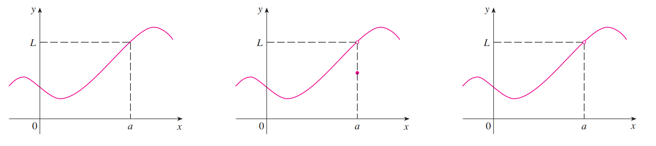
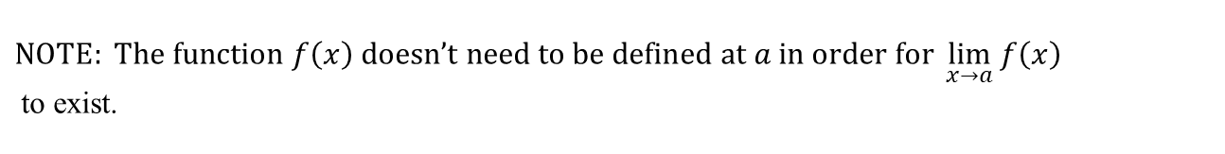
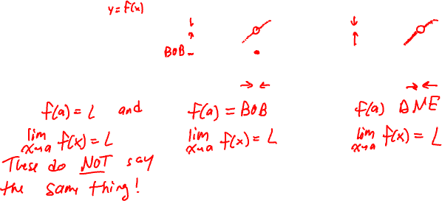
$$NOTE: The function f\left(x\right) doesn’t need to be defined at a in order for \lim_{x→a}{f\left(x\right)}$$ to exist.

Slide 5

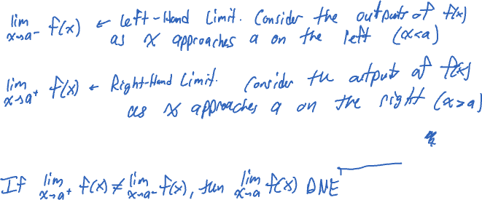
One-Sided Limits
When we write $\lim_{x→a}{f(x)}$, we indicate that $x$ is approaching $a$ from both sides.
Theorem: $\lim_{x→a^{+}}{f(x)}=\lim_{x→a^{−}}{f(x)}=L$ if and only if $\lim_{x→a}{f(x)}=L$.

Slide 6
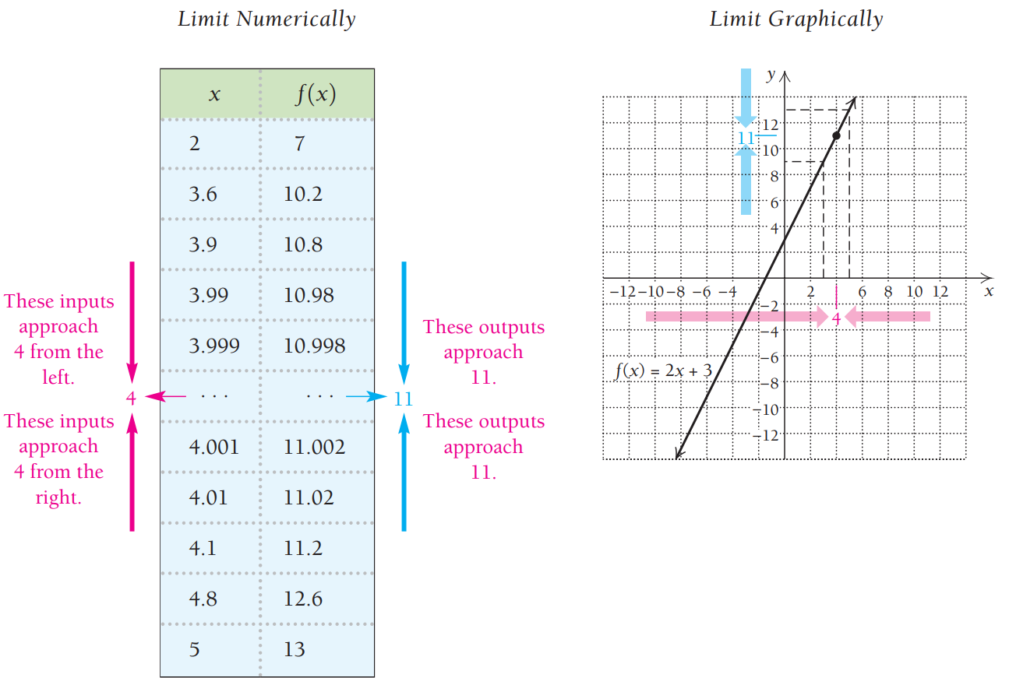
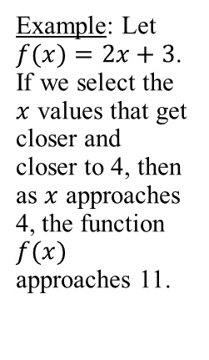
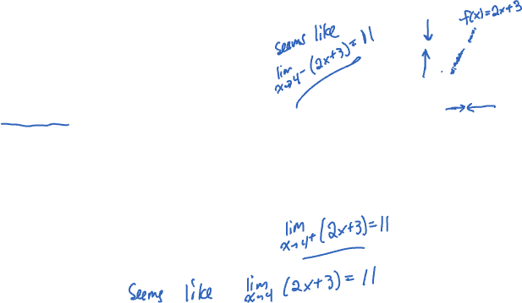
Limits Graphically and Numeraically
Example: Let $f(x)=2x+3$. If we select the $x$ values that get closer and closer to 4, then as $x$ approaches 4, the function $f(x)$ approaches 11.

Slide 7
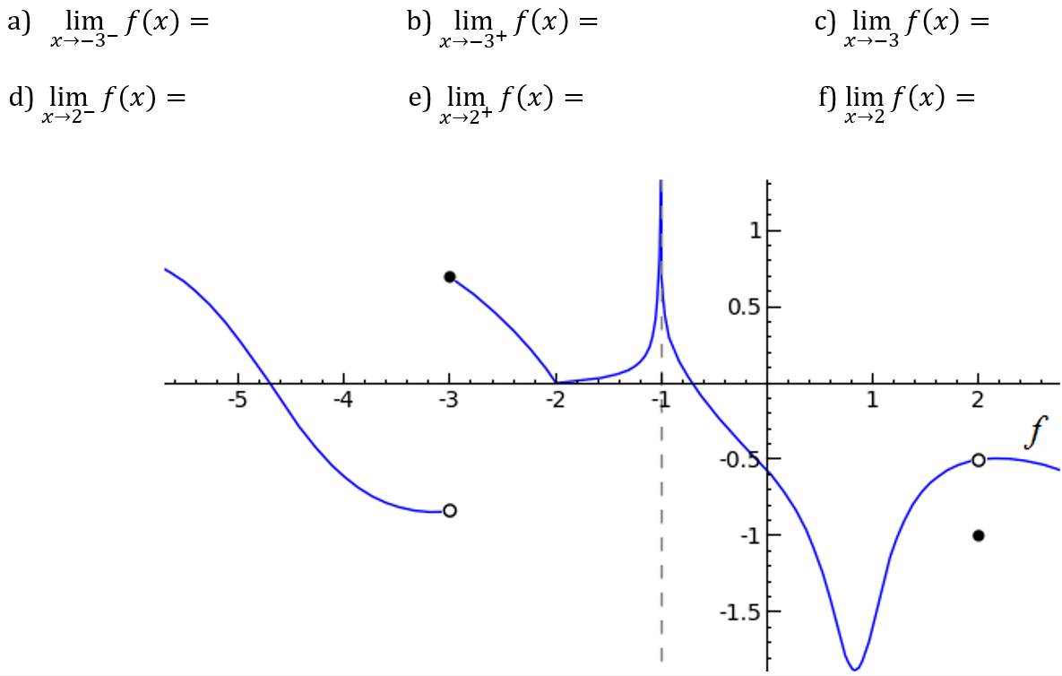


Graph Example
The graph of a function $f$ is shown below. Use it to state the values (if they exist) of the following:

Slide 8
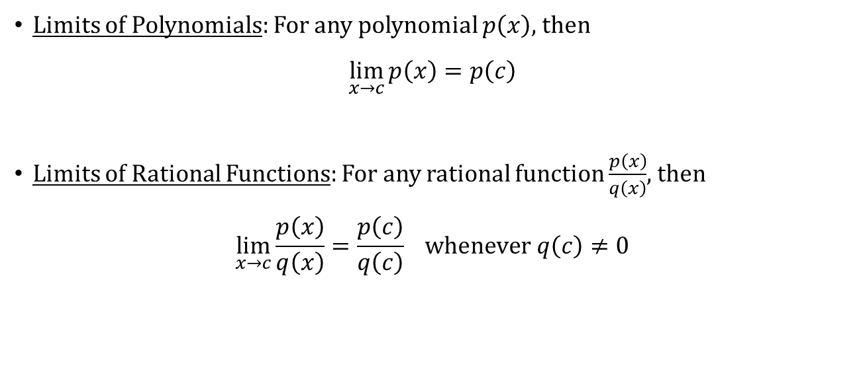

Useful Theorems
Limits of Polynomials: For any polynomial $p\left(x\right)$, then
$$\lim_{x→c}{p\left(x\right)=p\left(c\right)}$$
Limits of Rational Functions: For any rational function $\frac{p\left(x\right)}{q\left(x\right)}$, then
$$\lim_{x→c}{\frac{p\left(x\right)}{q\left(x\right)}=\frac{p\left(c\right)}{q\left(c\right)}} whenever q\left(c\right)≠0$$

Slide 9

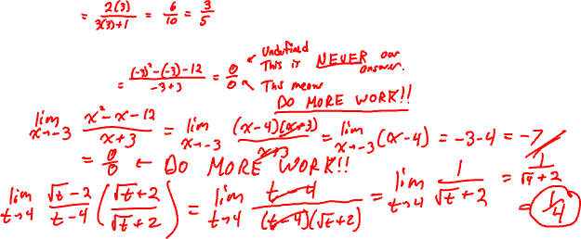
Examples
Find each of the following limits.
$$\lim_{x→3}{\frac{2x}{3x+1}}$$
$$\lim_{x→−3}{\frac{x^{2}−x−12}{x + 3}}$$
$$\lim_{t→4}{\frac{\sqrt{t}− 2}{t−4}}$$

Slide 10
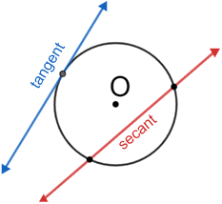
Secant versus Tangent
Secant comes from the latin root secare,
meaning “to cut”.
  The secant is a line which “cuts” the circle
  into two pieces.
Tangent comes from the latin tangere,
meaning “to touch”.
  The tangent is a line which “touches” the
  circle at exactly one point.
  It also meets the radius (or diameter) at a
  right angle.

Slide 11
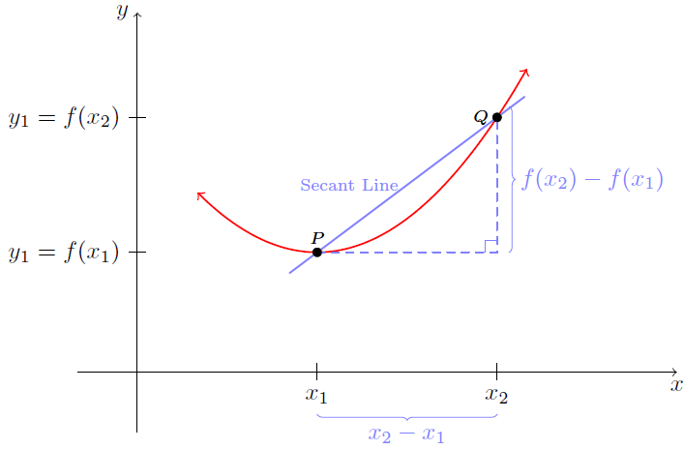
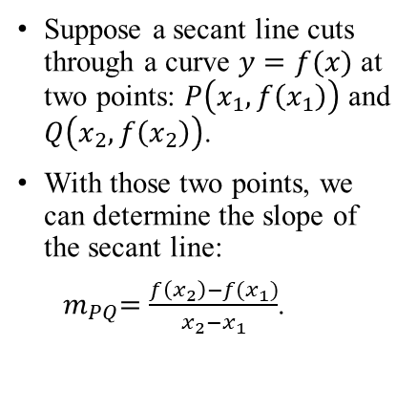
Secant Line
Suppose a secant line cuts through a curve $y=f(x)$ at two points: $P\left(x_{1},f\left(x_{1}\right)\right)$ and $Q\left(x_{2},f\left(x_{2}\right)\right)$.
With those two points, we can determine the slope of the secant line:
${ m}_{PQ}=\frac{f\left(x_{2}\right)−f(x_{1})}{x_{2}−x_{1}}$.

Slide 12

Secant Line Examples
For the function $f\left(x\right)=x^{2}−1$, find the slope of the secant line through the points $\left(2, 3\right)$ and $(3, 8)$.
Write the equation of the secant line.

Slide 13

Secant Line Examples
For the function $f\left(x\right)=x^{2}−1$, find the slope of the secant line through the points $\left(2, 3\right)$ and $(2.1, 3.41)$.

Slide 14

Secant Line Examples
For the function $f\left(x\right)=x^{2}−1$, find the slope of the secant line through the points $\left(2, 3\right)$ and $(2.01, 3.041)$.

Slide 15
The Tangent Problem
A tangent line only touches a curve at one point.
Without a second point, how can we determine its slope?

Slide 16
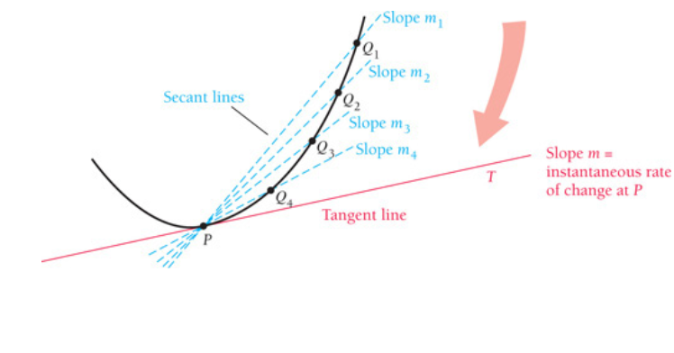

Answer
With two points $P\left(a,f\left(a\right)\right)$
and $Q\left(x,f\left(x\right)\right)$, the slope
of the secant line is
$m_{PQ}=\frac{f\left(x\right)−f\left(a\right)}{x−a}$.
As $Q$ approaches $P$ (that is, when the distance between $x_{1}$ and $x_{2}$ gets really small), the slope of the secant line approaches the slope of the tangent line at $P$.

Slide 17
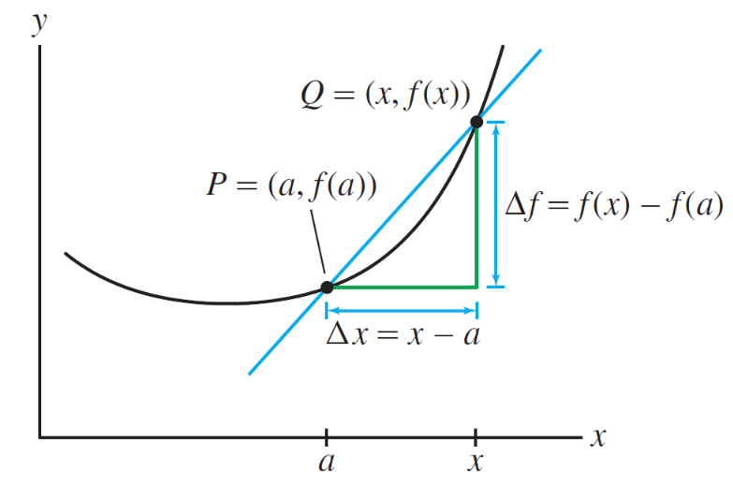

Tangent Slope
Consider the distance between $x$ and $a$ to be some really small value $h$. That is, $h=x−a$. Then we can write $x=a+h$.
Thus, the slope of the tangent line can be approximated at a single point $P\left(a,f\left(a\right)\right)$ using a really small value $h$:
$m=\frac{f\left(a+h\right)−f\left(a\right)}{(a+h)−a}=\frac{f\left(a+h\right)−f\left(a\right)}{h}$

Slide 18
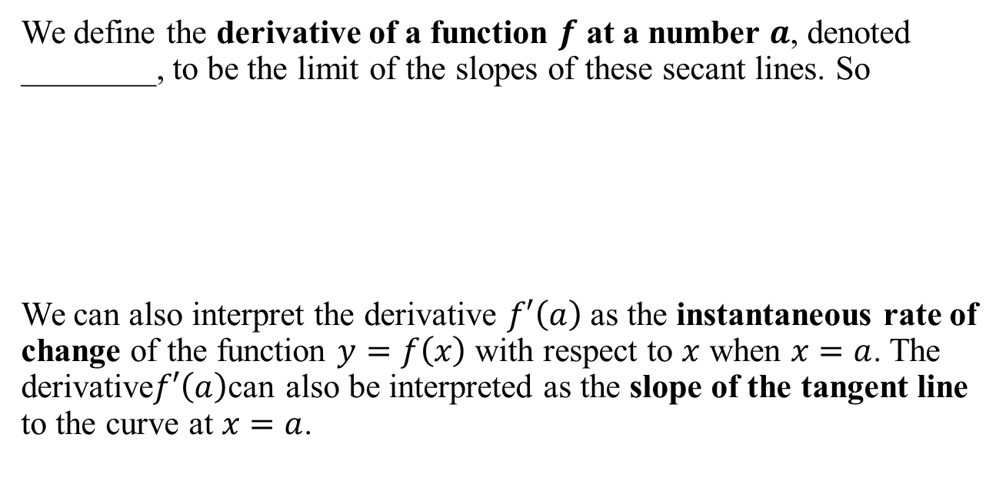
The Derivative at a Point
We define the derivative of a function $f$ at a number $a$, denoted ________, to be the limit of the slopes of these secant lines. So
We can also interpret the derivative $f′\left(a\right)$ as the instantaneous rate of change of the function $y=f\left(x\right)$ with respect to $x$ when $x=a$. The derivative$f′\left(a\right)$can also be interpreted as the slope of the tangent line to the curve at $x=a$.

Slide 19

Tangent Slope Example
For the function $f\left(x\right)=x^{2}−1$, find the slope of the tangent line at the point $\left(2,3\right).$

